Slide 1
Journey into Oneness.
Make them one as we are one.

Slide 2
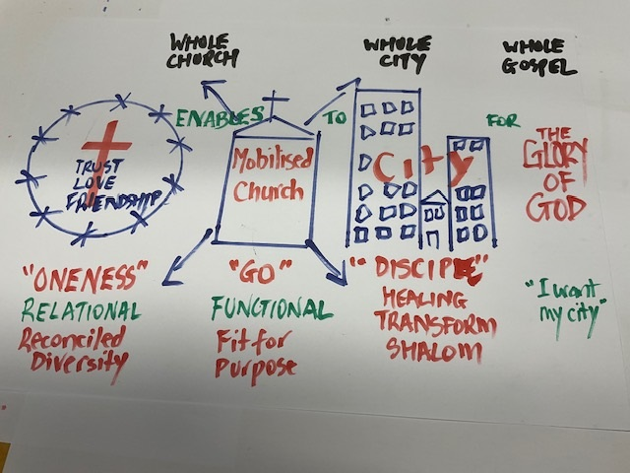

Slide 3
momentum and maturity
Value the long road of friendship.
Regular rhythm of intentionally being together.
Always open invitation. Reason to invite.
Vision – develop a shared understanding and articulation of the groups’ identity and purpose.
“revisiting, reclarifying, and recommitting to identity and purpose on a regular basis contributes to strong and enduring communities.” Michael Wood Practicing Peace

Slide 4
momentum and maturity
Leaders retreat.
Core facilitation team (catalyst, weaver, facilitator, coordinator, mobiliser.)
Leader Gatherings are Co-lead, Co-creative spaces (critical conversations)
Plan (what:Goal 10% → when/Timeline 40% → how/Plan 50% → who/Accountability 95%)
Prayers of lament – head and heart (current reality + Hope for the future)
Local church leaders, marketplace leaders, engagement.
Combined church city prayer.

